Slide 1
Capstone project
Signal prediction with time-series models

Slide 2
Information about the raw data
Three datasets:
US Sector Inst ETF.csv
US Sector Institutional MF.csv
US Sector Retail MF.csv
These datasets contains the same columns:
ReportDate: Weekly data from 2006 to 2017
AssetClass: Name of the portfolio
Flow: How much money (million$) is coming in or going out
FlowPct: Flow/Assets beginning this week * 100%
AssetsEnd: Assets at the end of this week (million$)
PortfolioChangePct: Percent change in overall portfolio during the week

Slide 3
Who’s using the model?
Our team serves as a fund manager of FOF, the product we want to invest in is the 20 portfolios in our datasets.
We are working on building a model to help us decide our investment strategy.
Our main goal is to define and identify “tradable signals” based on historical data.

Slide 4
Cleaning data
Missing data:
Infrastructure: missing in all 3 datasets -> drop

Slide 5
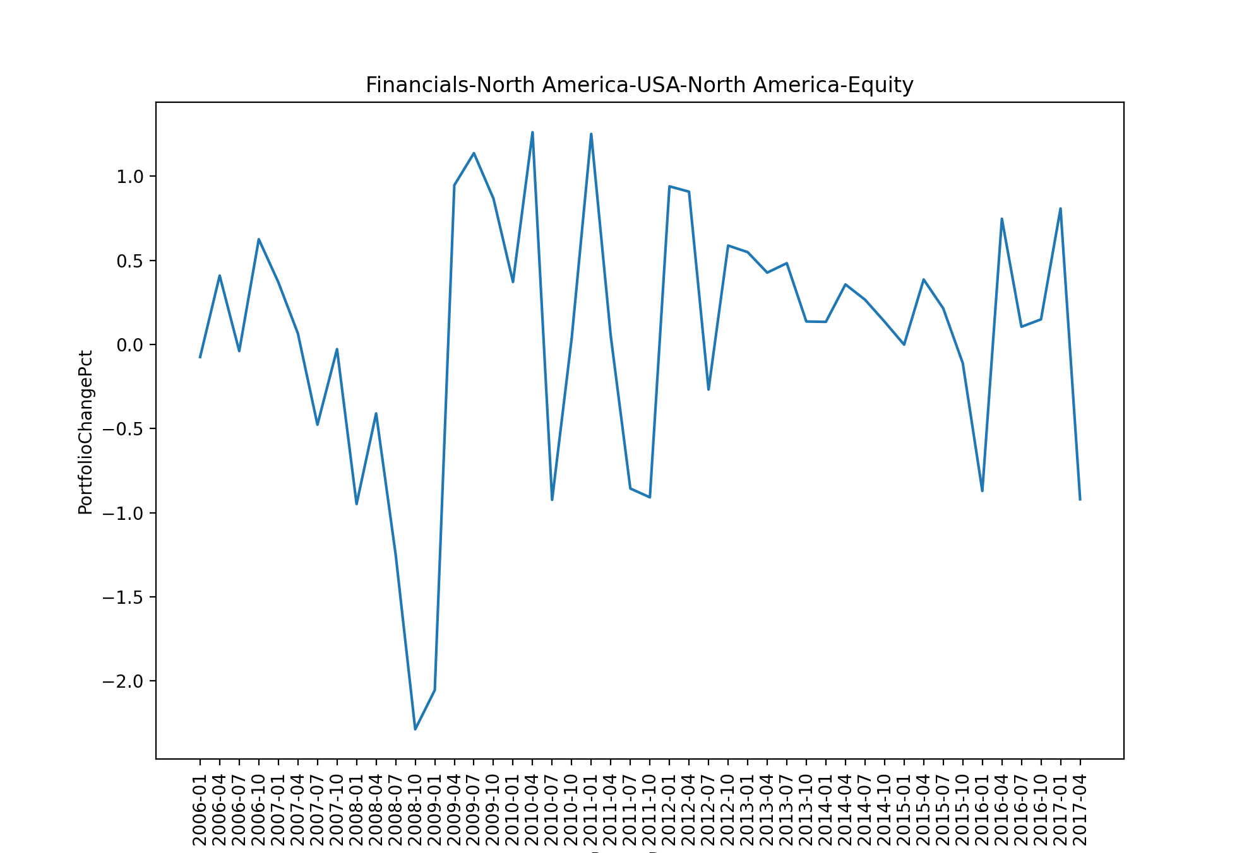
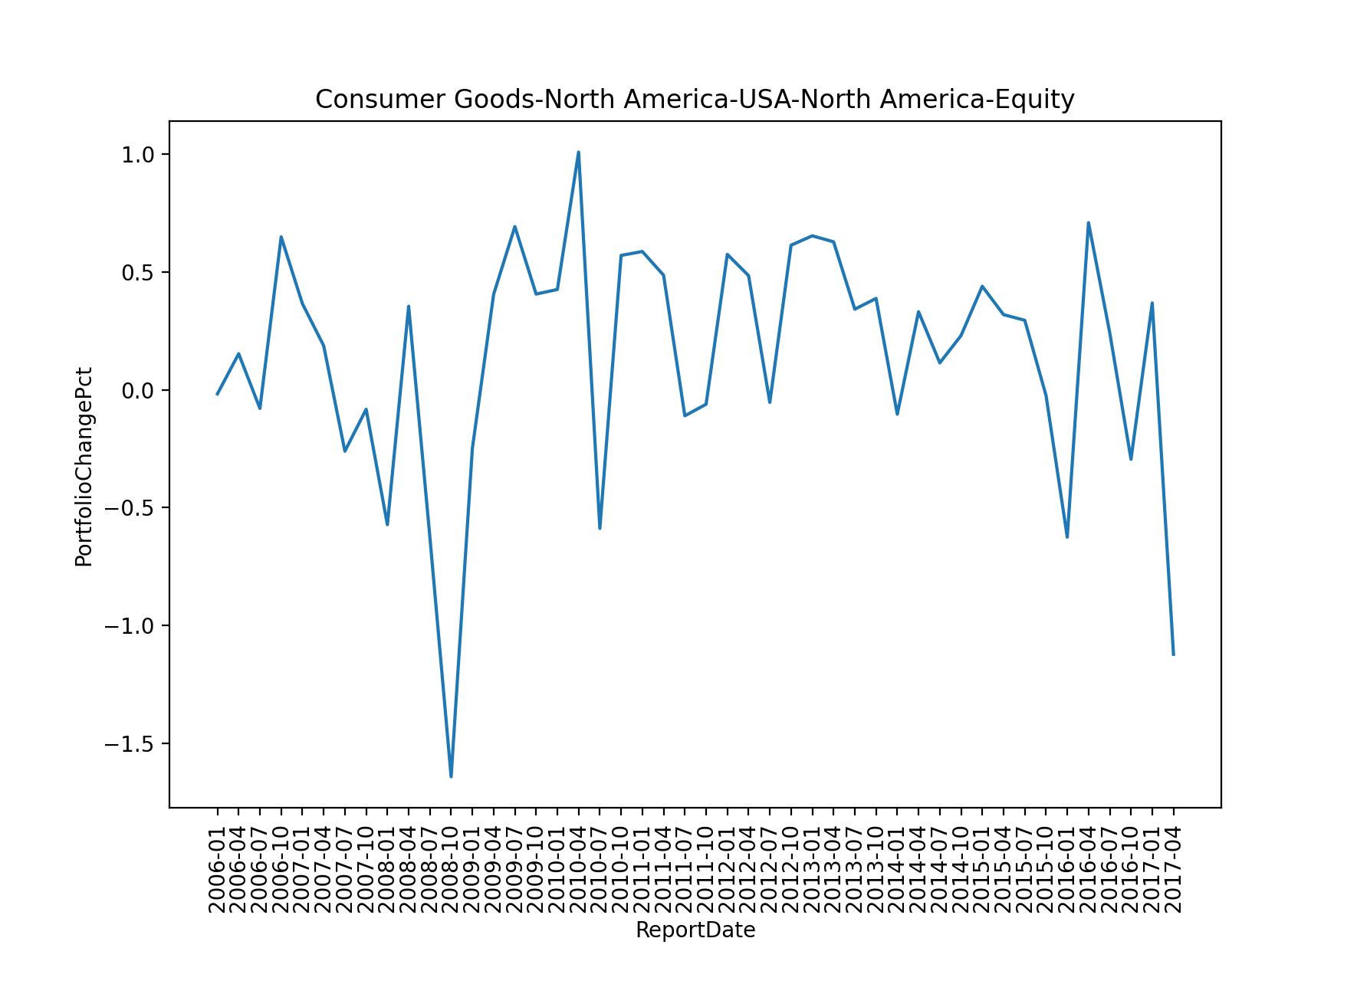
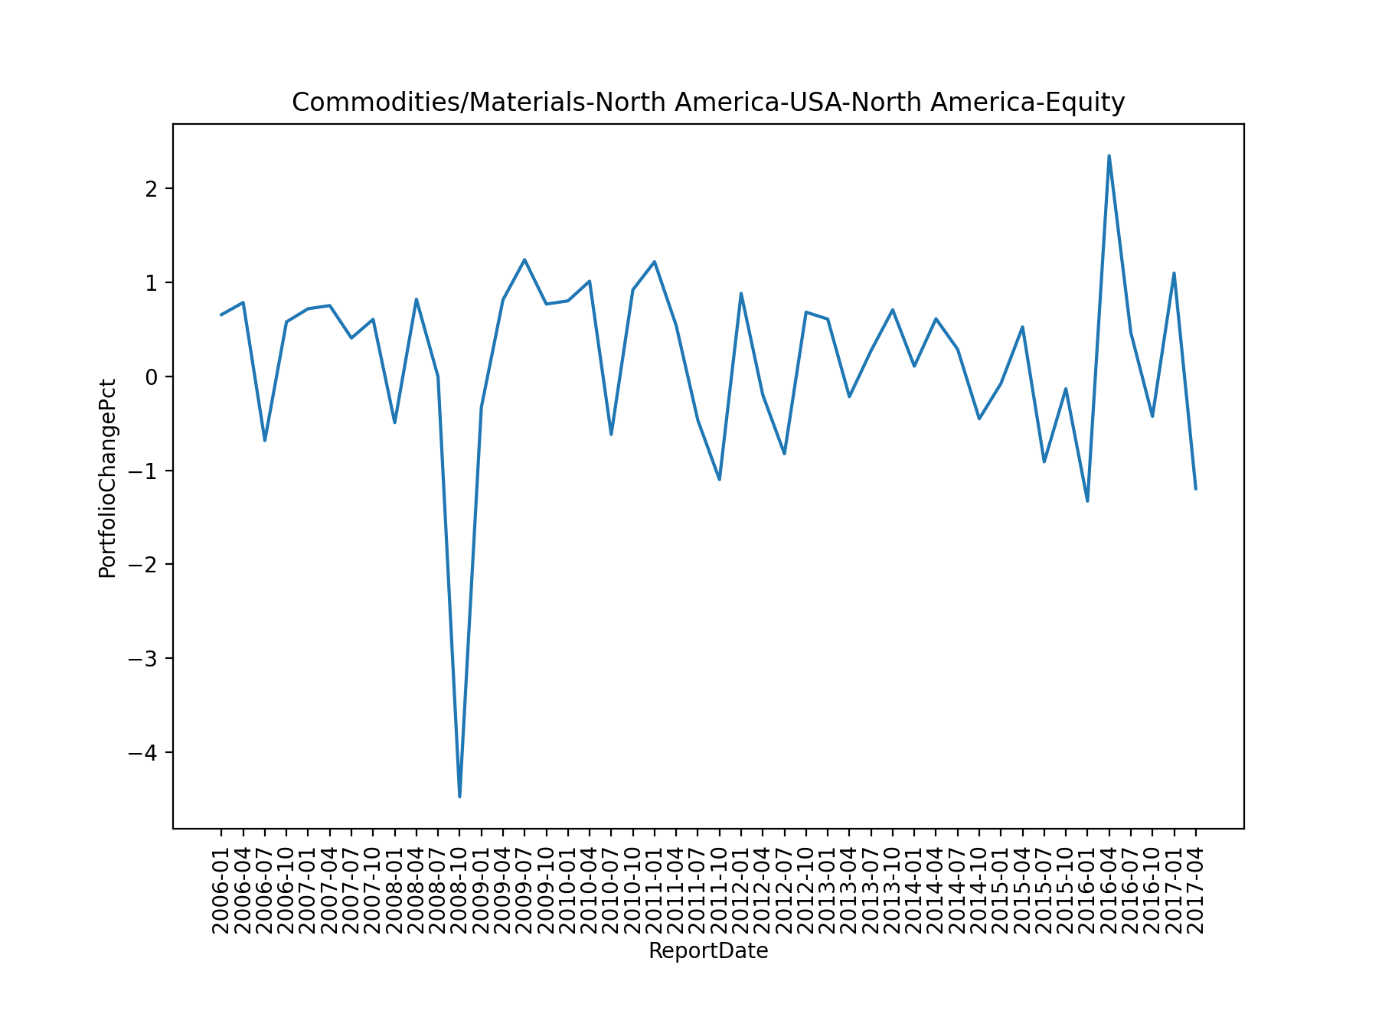
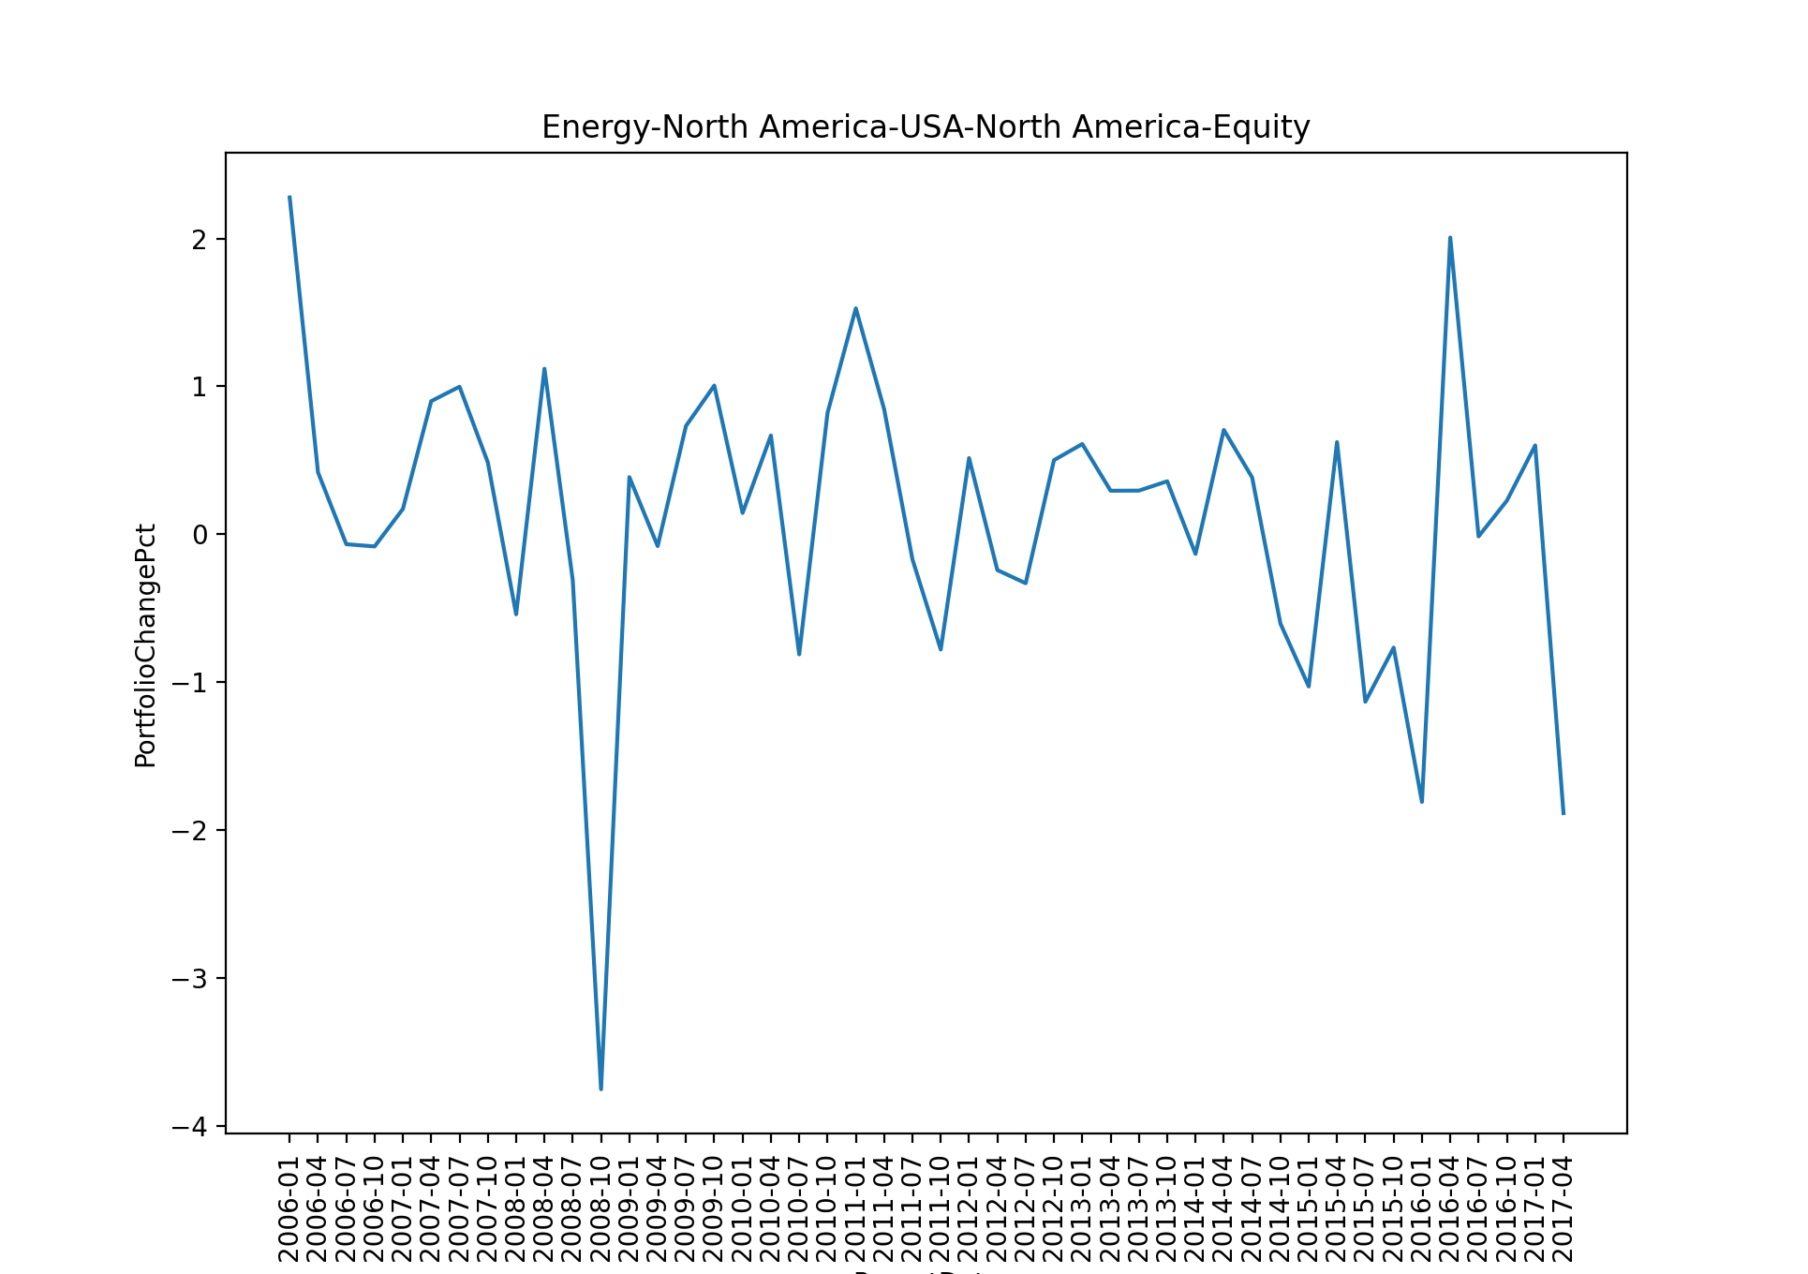
EDA
Average Portfolio Change Percent for every three months

Slide 6
EDA
Common trend across different portfolios:
A dive at around Oct 2008.
An upsurge at around April 2016.
These signals are telling us there were some factors about the entire economics that would have impact for all the industries.
We should eliminate the influence of the general economics when building models for these portfolios.

Slide 7
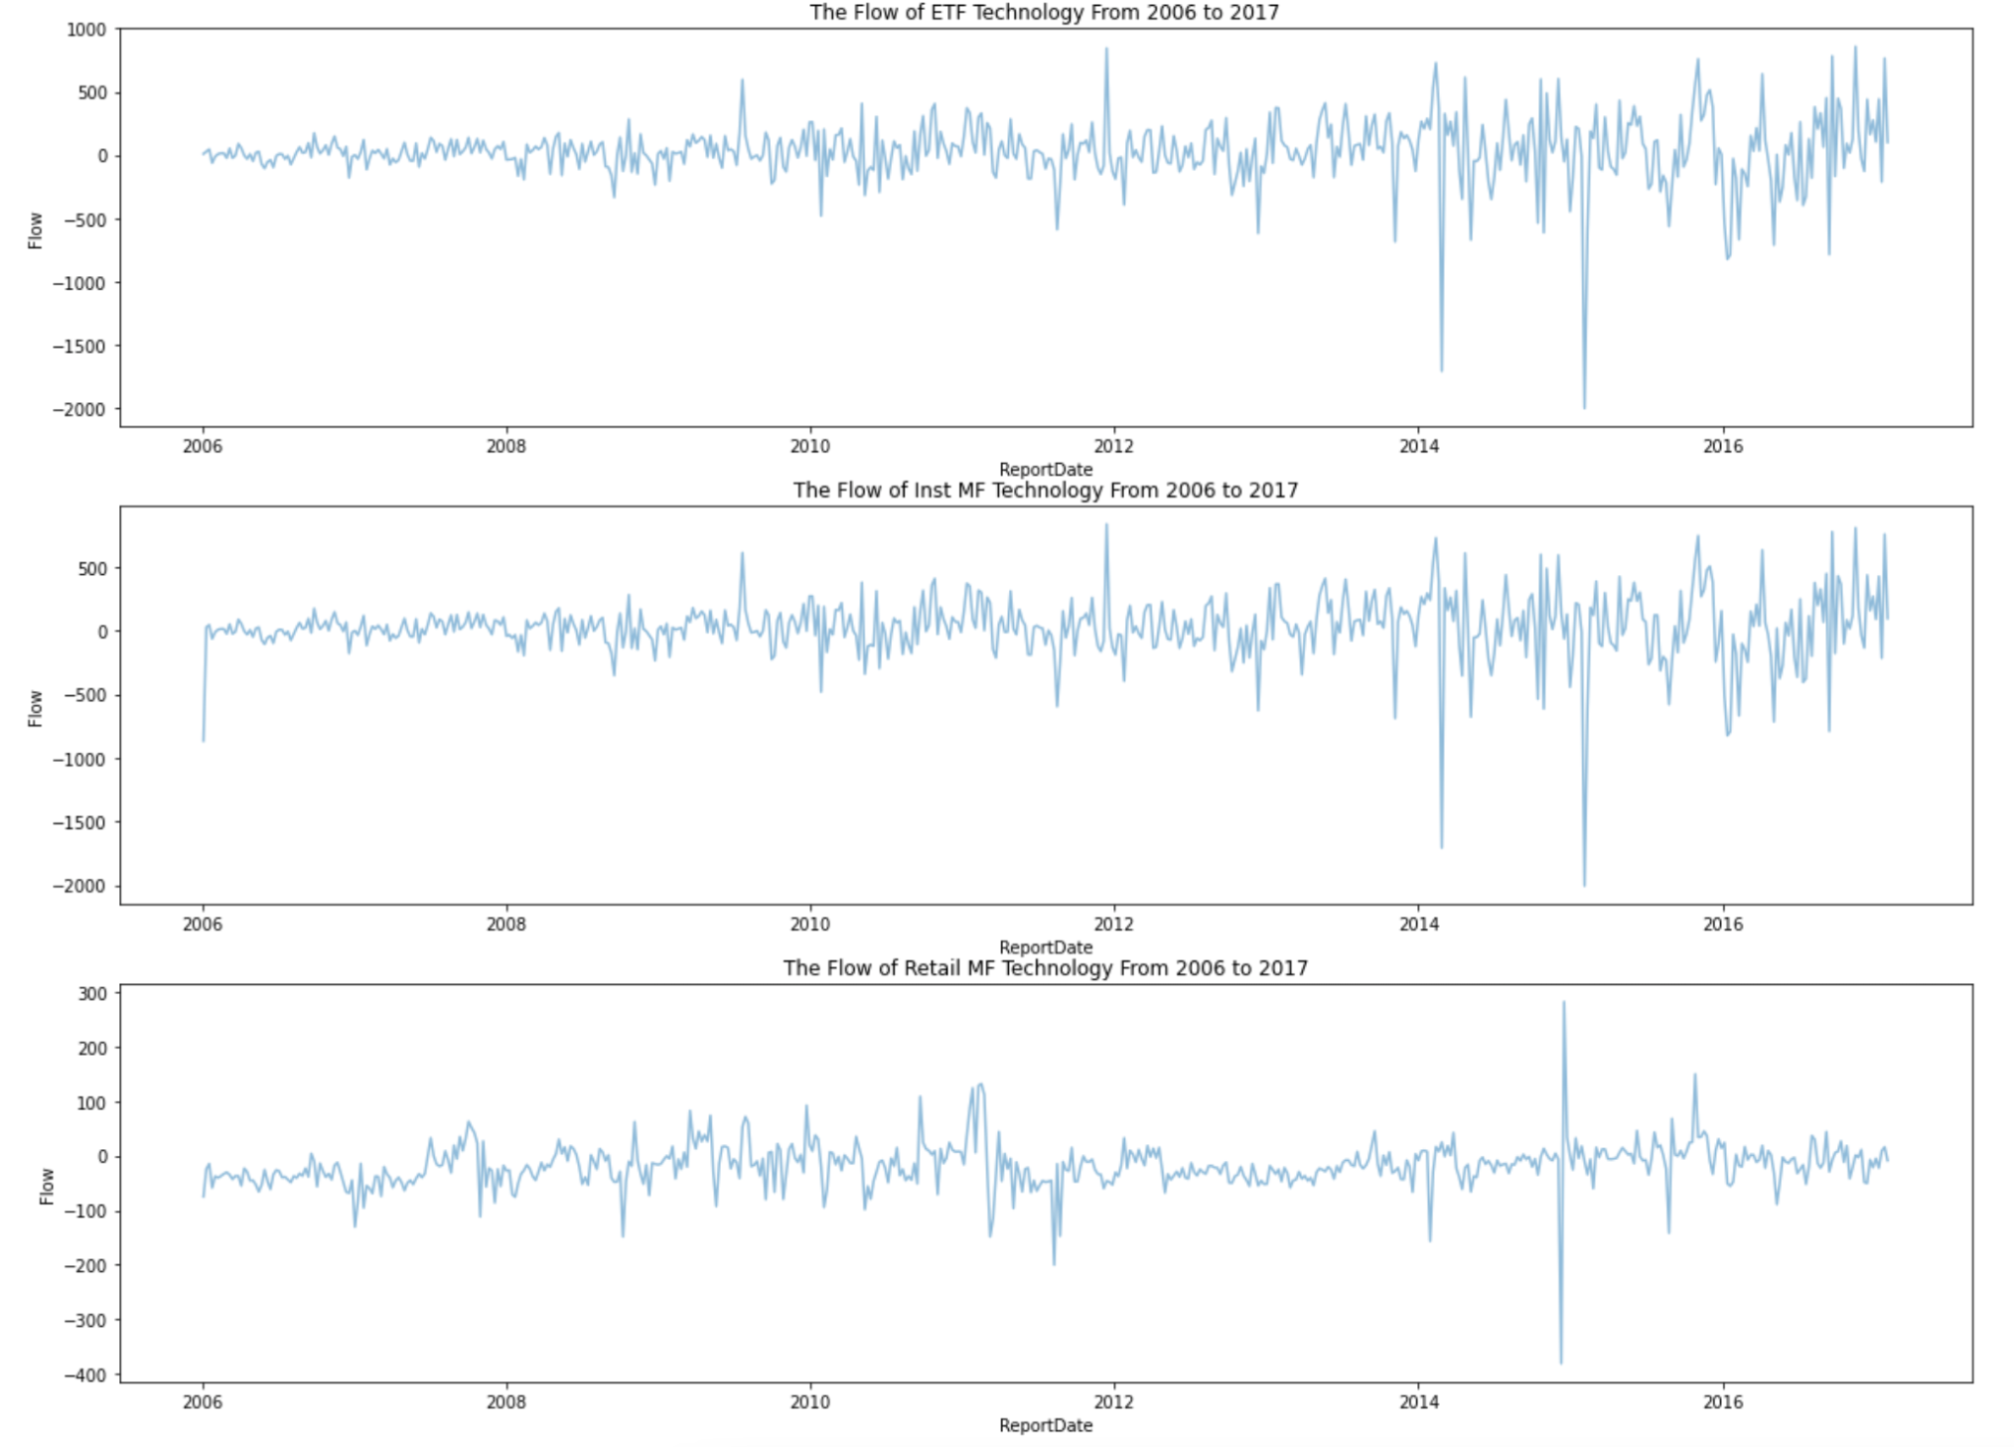
EDA - Flow Change in Time Series
For institutions, the flow change of ETF and Mutual Funds in most asset classes (Technology as example) follow the similar pattern in the past 10 years.
For individual investors, starting 2012, the flow change is relatively shrinked compared to the institutional flow changes.
In late 2014-early 2015, retail investors made high flow fluctuation moves with institution flow drop as the consequences.

Slide 8
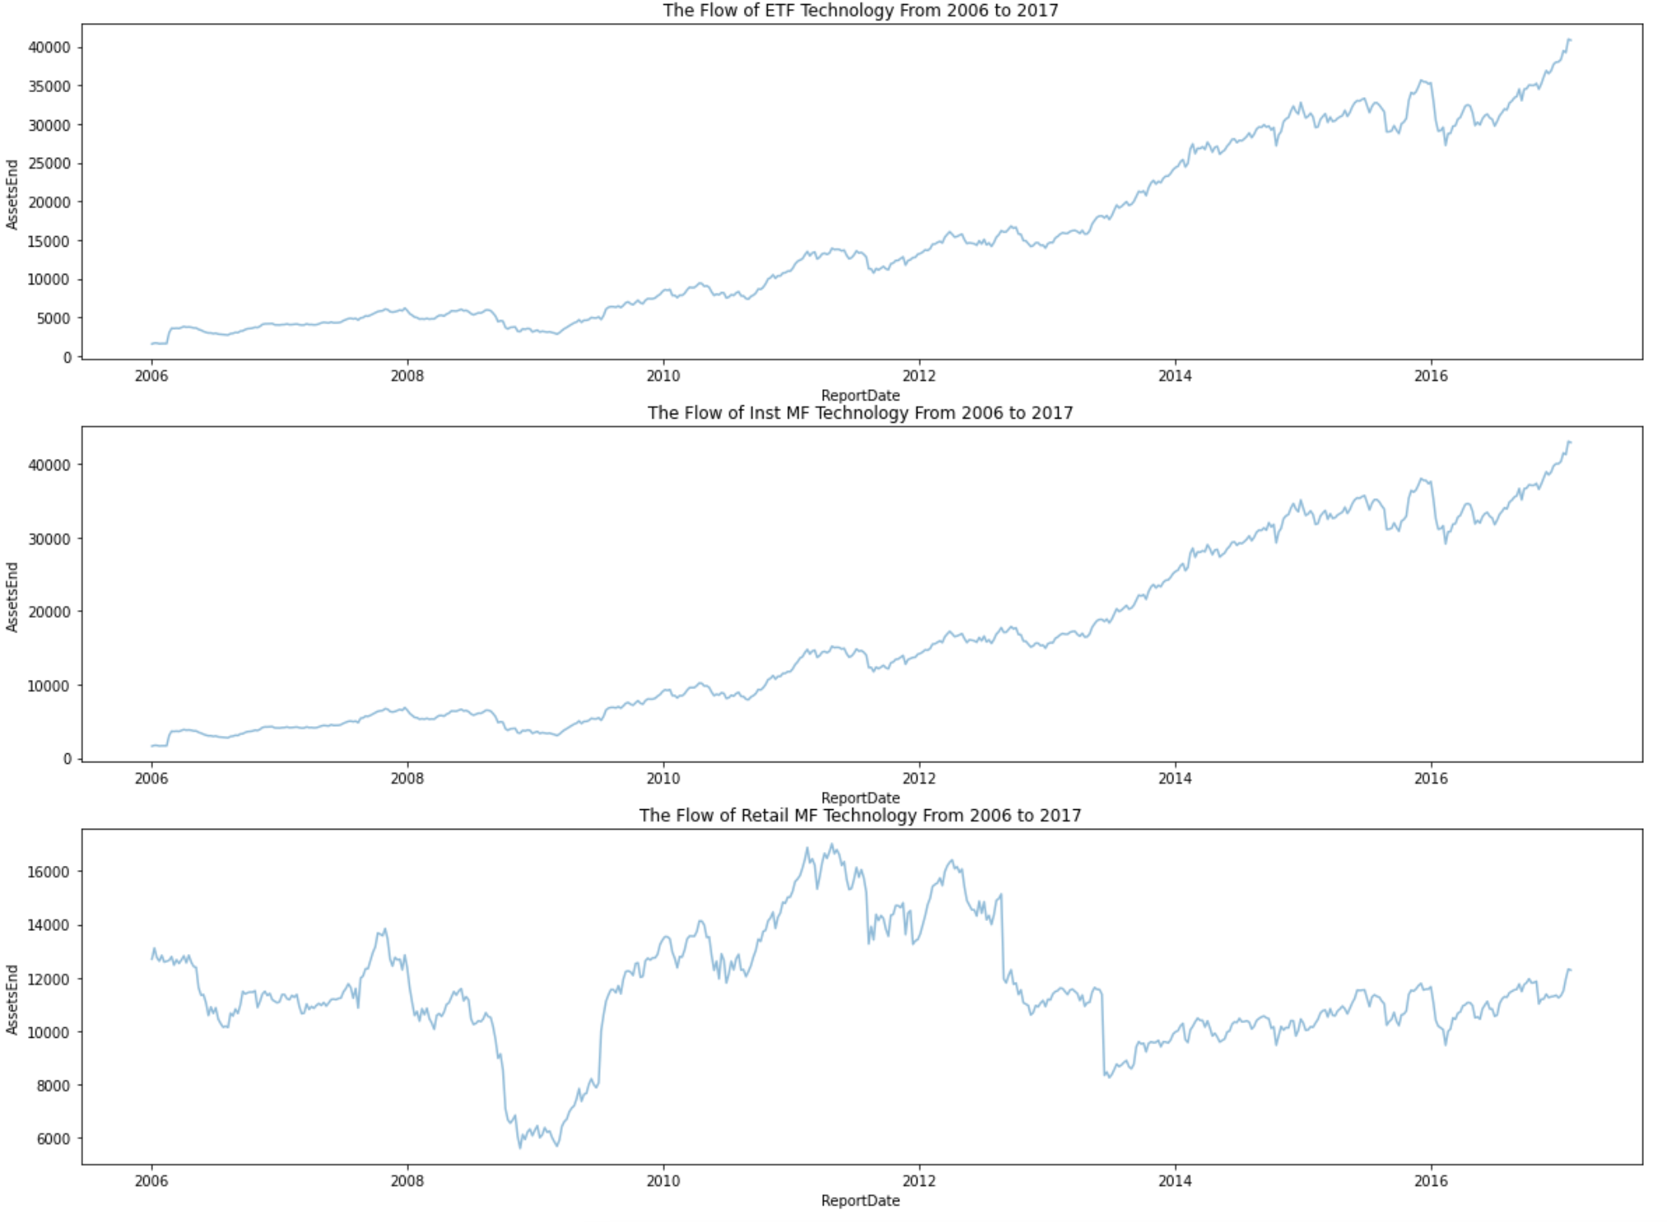
EDA - Asset End Change in Time Series
For institutions, the asset end change of ETF and Mutual Funds in technology class follow the similar steady increase pattern in the past 10 years.
For individual investors, the asset end change of Mutual Funds in technology experience high fluctuation in the past ten years.

Slide 9
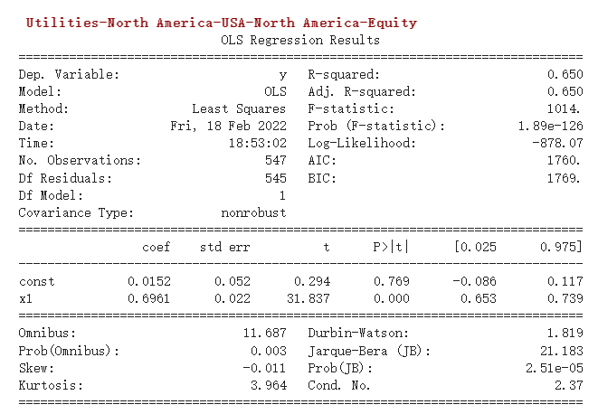
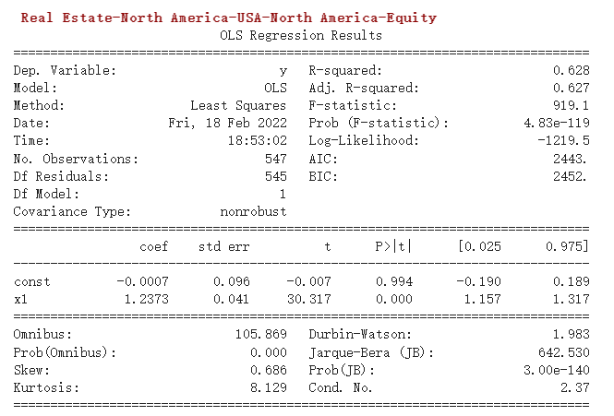
Adjusting the Target Variable
PortfolioChangePct = β*sp_change + α + residual(other factors)
Notes:
present more about thought process and not get too technical
Rf: interest rate. Rm: return of the whole market
the purpose
residual is the signal

Slide 10
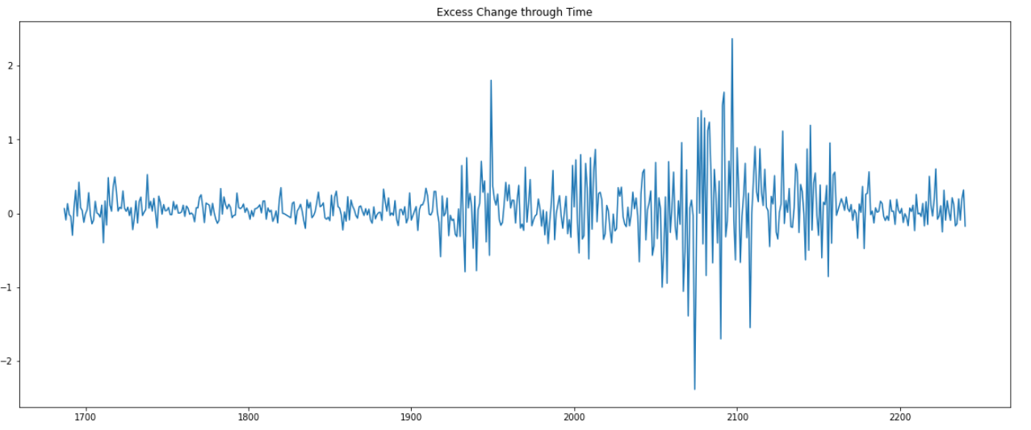
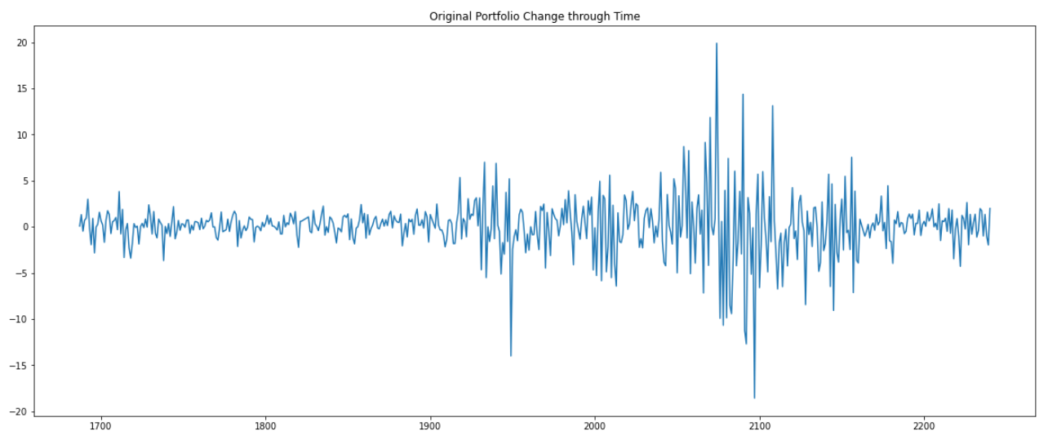
Financial Industries

Slide 11
Classification model steps
Determine x (input variables)
Determine real future y (which is signal to buy) 0 -1
Model assessment: Compare it with true future performance to get accuracy of the model

Slide 12
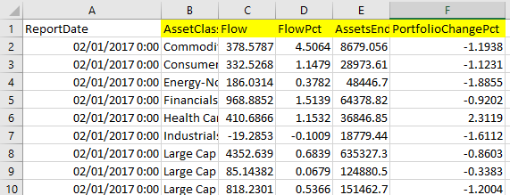
Our approach
Determine x (input variables) – in the 3 tables and the public data (SP500,….)
Determine true future performance y (which is signal to buy) 0 -1
Classification model (with logistic as baseline), VAR, ARIMA, LSTM
Model assessment: Compare it with true future performance to get accuracy of the model
MA25 of AssetEnds: Basically compare with AssetEnds of 25 weeks into the future. If it increases 5% then replace with 1, if it doesn’t change then 0, if it decreases 5%+ then -1

Slide 13
VAR model
What it does?
multivariate time series model
Notes:
https://towardsdatascience.com/multivariate-time-series-forecasting-456ace675971

Slide 14
The test before the model
Granger’s Causality Test
Augmented Dickey–Fuller (ADF) Test: Before applying VAR, both the time series variable should be stationary, if not stationary, perform difference
Durbin Watson Statistic Test
The optimal model is then the model VAR(p) which minimizes some lag selection criteria. The most commonly used lag selection criteria are:
Akaike (AIC)
Schwarz-Bayesian (BIC)
Hannan-Quinn (HQ).
These methods are usually built into software and lag selection is almost completely automated now.

Slide 15
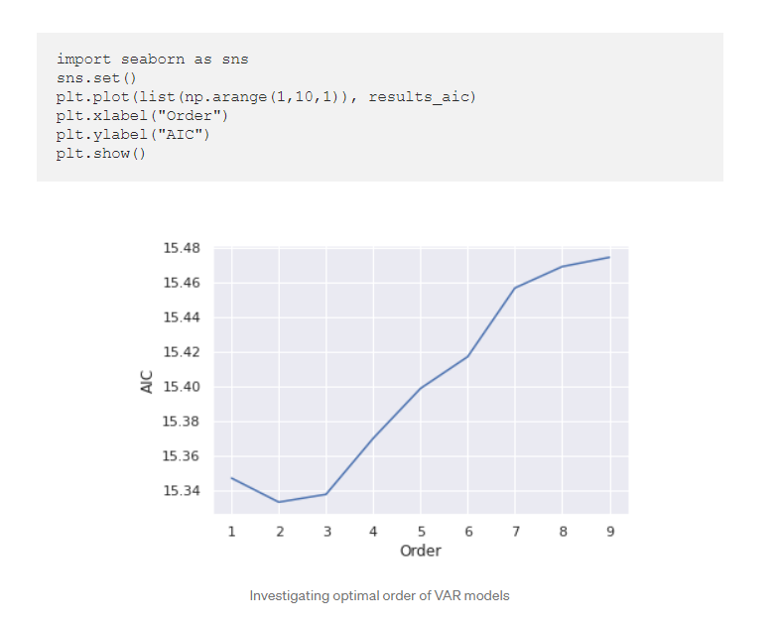
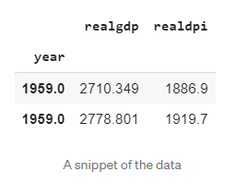
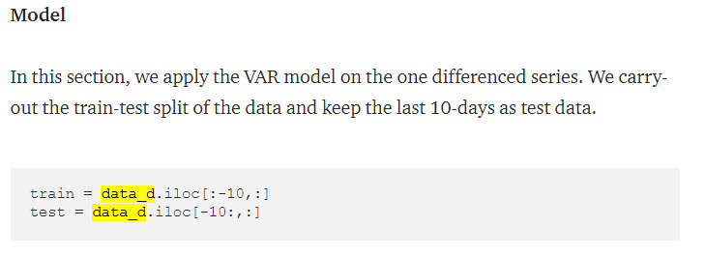
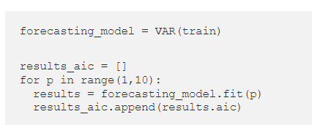
The code
adfuller
adfuller
differencing

Slide 16
